Slide 1
Goal-Oriented Requirements Engineering (GORE)
Understanding the "Why" behind the System
Ms. Shehla Saeed
Notes:
Welcome to the session. Today, we are shifting our focus from what a system should do, to why it needs to do it.

Slide 2
Learning Objectives
Understand Goal-Oriented Requirements Engineering
Identify goals, tasks, and softgoals
Learn goal modeling techniques
Convert goals into requirements

Slide 3
What is Goal-Oriented RE?
The Paradigm Shift:
Traditional RE focuses on system features ("what the system should do "). GORE focuses on the intentions and rationale (" why it should do it ").
In GORE
Stakeholders’ objectives/goals are identified first
Requirements are derived from these goals
Focus is on why the system is needed
Example:
Goal Improve parking availability in the city
Requirement System should display real-time parking availability.

Slide 4
Why Use Goal Models?
Requirements Elicitation: Helps discover hidden requirements by repeatedly asking "Why?" and "How?".
Traceability: Provides a clear link from high-level business strategy down to low-level technical implementation.
Conflict Resolution: Helps identify conflicting goals early (e.g., "High Security" vs. "Easy to Use") so stakeholders can negotiate trade-offs.
Completeness: Ensures every implemented feature is actually tied to a business need (preventing gold-plating).
Notes:
Keep asking Why until the requirement either collapses… or reveals its true purpose.” annoyingly curious
“Every feature should have a reason to exist—or it’s intellectual clutter.”
Traceability is about connecting the dots from:
Business Goal → Stakeholder Goal → System Requirement → Design → Code

Slide 5
What is a Goal in RE?
Definition: A goal is an objective that the system under consideration should achieve.
Stakeholder intentions are captured as goals
Requirements are derived from these goals
Scope: Goals can range from high-level strategic business objectives (e.g., " Improve parking management ") to low-level technical requirements (e.g., " Detect free parking slots ").

Slide 6
Types of Goals
Hard Goals → measurable → functional behavior Soft Goals → quality attributes → non-functional requirements

Slide 7
Hard Goals → Usually Functional Requirements
A hard goal has clear success criteria.
Examples (Smart Parking System)
Hard Goal Reserve parking space
Derived Functional Requirement System shall allow users to book a parking slot via mobile app.
Hard Goal Display available parking slots
Derived Functional Requirement System shall show real-time parking availability.
These describe system actions, so they become functional requirements.

Slide 8
Soft Goals → Usually Non-Functional Requirements
A soft goal describes quality or performance.
Example
Soft Goal System should be user friendly
Derived Non-Functional Requirement The mobile app should allow users to complete booking within 3 steps.
Soft Goal System should be secure
Derived Non-Functional Requirement All payments must use encrypted transactions.
Soft goals usually relate to qualities like:
Usability, Performance, Reliability,Security,scalability

Slide 9
Goal Refinement/Goal Decomposition
Large goals are broken into smaller goals
Process known as goal decomposition
Helps derive clear system requirements
Example:
Goal Improve parking management
Sub goals
Detect free parking slots
Guide drivers to available slots
Enable online payments
Eventually these goals become system requirements.

Slide 10
Goal Decomposition & Relationships
AND decomposition: all sub-goals required
OR decomposition: any one sub-goal sufficient
Contribution Links (Impacts): Used primarily for softgoals to show how a task affects an objective.
Make (++): Strongly positive impact.
Help (+): Weakly positive impact.
Hurt (-): Weakly negative impact.
Break (--): Strongly negative impact.

Slide 11
AND decomposition
An AND relationship means all sub-goals must be satisfied to achieve the main goal.
If even one sub-goal fails, the main goal fails.
Example – Smart Parking System
Main Goal Enable Online Parking Service
To achieve this, several things must happen.
Parking spaces must be detected
A mobile application must exist
Payment must be processed

Slide 12
OR Decomposition (OR Goal)
An OR relationship means any one sub-goal can achieve the main goal.
Multiple alternative solutions exist.
Example – Parking Reservation
Goal Allow Parking Reservation
There are multiple ways to achieve it.
Drivers can reserve parking by:
Mobile application OR
Parking kiosk machine
Either option satisfies the goal.

Slide 13
Goal Conflicts
Some goals conflict with others
Example: security vs usability
Goal modeling helps analyze trade-offs
Example
Goal 1 Provide strong security
Goal 2 Provide quick access
More security can slow down access.
Goal modeling helps analyze and balance such trade-offs.

Slide 14
Goal Modeling Techniques
While the core concepts remain the same, several frameworks provide specific notations and methodologies:
KAOS (Knowledge Acquisition in automated Specification):
Focuses on formal, mathematically rigorous goal refinement and system behavior.
i* (i-star)
Focuses on actors, their intentions, and social dependencies.
Tropos
Tropos is unique because it takes the goal-oriented, agent-based philosophy and stretches it across the entire software development lifecycle.

Slide 15
The KAOS Framework
Core Philosophy: A systematic, formal approach from high-level goals down to precise object models and state transitions.
Key Elements:
Goal Model: AND/OR graphs of goals.
Responsibility Model: Assigning terminal goals (requirements) to specific agents.
Object Model: The domain entities involved in the goals.
Operation Model: The specific system behaviors that fulfill the requirements.

Slide 16
The i (i-star) Framework*
Core Philosophy: Systems involve social networks of intentional actors who depend on each other.
Strategic Dependency (SD) Model: Shows who depends on whom for what (Goals, Tasks, Resources).
Strategic Rationale (SR) Model: Looks "inside" an actor to show how their internal goals are met and what alternatives exist.
Example: A bank might depend on an IT provider for "System Maintenance," which is broken down into "Regular Updates" and "Security Patches."

Slide 17
The Tropos Methodology
What is Tropos?
An agent-oriented software development methodology tailored for distributed, complex systems.
The i Connection:*
Tropos adopts the i* (i-star) modeling language (Actors, Goals, Tasks, Resources, Dependencies) as its foundational notation.
The Big Differentiator:
Instead of changing modeling languages when moving from requirements to design (e.g., switching from Goal Models to UML Class Diagrams), Tropos uses the exact same agent-oriented concepts from the first stakeholder meeting all the way down to writing the code.

Slide 18
Analyzing and Evaluating Goal Models
Qualitative Evaluation: Using contribution links (+, -, etc.) to evaluate if a softgoal is sufficiently "satisficed" based on chosen design alternatives.
Quantitative Evaluation: Assigning numerical weights and probabilities to goals for mathematical decision-making.
Identifying Obstacles: Modeling anti-goals (things we don't want to happen, like "System hacked") and designing mitigation goals.

Slide 19
Qualitative Evaluation – Satisficing Softgoals
The Challenge:
How do we measure things that don't have hard numbers, like "Security" or "Usability"?
The Concept of "Satisficing":
A term coined by Herbert Simon (Satisfy + Suffice). It means a goal is met to an acceptable degree rather than strictly verified.
Contribution Links: We evaluate alternatives based on how they impact higher-level softgoals using qualitative labels:
Make (++): Task guarantees the goal is satisficed.
Help (+): Task partially contributes to the goal.
Hurt (-): Task partially prevents the goal.
Break (--): Task completely denies the goal.
Bottom-Up Propagation: We start at the bottom of the graph (the concrete tasks) and propagate these labels upwards.
If a task "Helps" Usability but "Hurts" Security, stakeholders can visually see the trade-off and make a judgment call.

Slide 20
Quantitative Evaluation – Doing the Math
The Challenge:
Sometimes qualitative labels are too vague. When deciding between a $100k system architecture and a $500k one, stakeholders want numbers.
Assigning Weights: Higher-level goals are assigned numerical weights based on priority (e.g., Security = 0.7, Performance = 0.3).
Assigning Scores/Probabilities: Alternative tasks or system designs are given scores based on how well they fulfill the goals (e.g., Task A has a 90% probability of meeting the Performance goal, but only 40% for Security).
Utility Functions: By multiplying the weights by the scores and summing them up, you can calculate a final "Utility Score" for different design alternatives.
The Result: The team simply chooses the architectural alternative that yields the highest overall mathematical score.

Slide 21
Obstacle Analysis – Expecting the Unexpected
What is an Obstacle?
A precondition or event that prevents a goal from being achieved. (e.g., Goal: "User is Authenticated." Obstacle: "User forgot password" or "Server is down").
Why Model Them?
System failures rarely happen because of what the system does; they happen because of what the system failed to anticipate. KAOS is specifically famous for rigorous obstacle analysis.
The Process:
Identify Obstacles: Take every terminal goal and ask, "How could this fail?" (Often done using fault-tree analysis).
Assess Impact: Is this a minor annoyance or a critical failure?
Generate Resolutions: We alter the goal model to handle the obstacle.

Slide 22
Example Scenario
Smart Parking System
Drivers waste time searching for parking
Goal: Reduce parking search time

Slide 23
High-Level Goal
Improve Urban Parking Management

Slide 24
Sub Goals
Detect parking availability
Provide mobile application
Enable parking reservation
Enable digital payment

Slide 25
Tasks
Install sensors
Develop mobile application
Integrate payment gateway

Slide 26
Goal to Requirement Example
Goal: Provide parking information
Requirement: System shall display real-time parking availability

Slide 27
Terminologies used in Goal Models
Goals (Optional Goals, Mandatory Goals)
Tasks and Plans
AND / OR decomposition
Precedence Links( +ive and –ive)

Slide 28
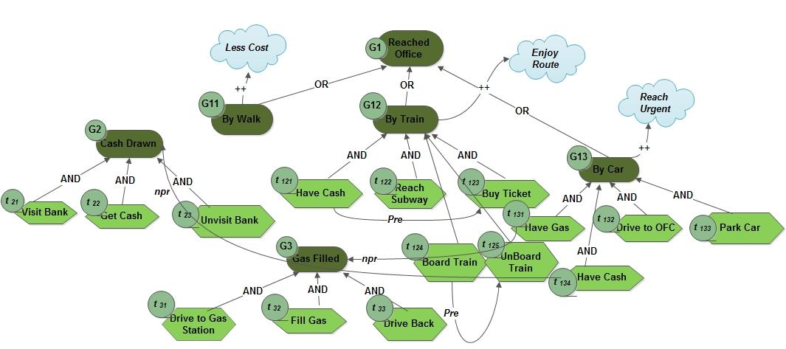


Slide 29
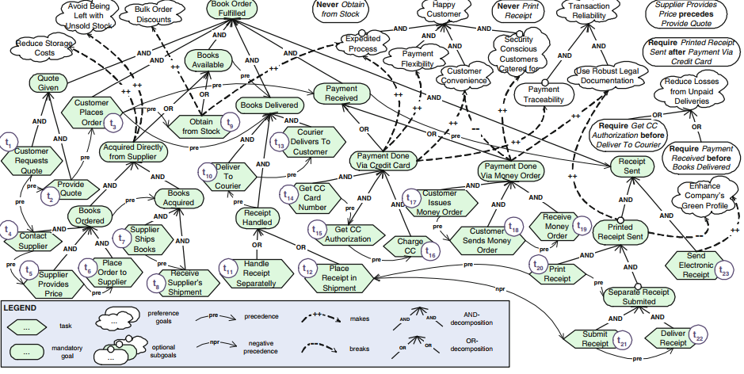

Slide 30
+ve Precedence
User Authentication → Reserve Parking Slot
Explanation
User must log in first
Then they can reserve parking
If authentication fails → reservation cannot proceed.

Slide 31
-ve Precedence
A negative precedence means one action or goal must NOT happen before another, or one condition prevents another.
Think of it as:
“This should not occur unless something else has happened” or “If this happens, that must NOT happen”
Example – Smart Parking SystemPayment
Payment Failed ⟶ NOT Confirm Booking
Explanation
If payment fails
System must prevent booking confirmation
This is a safety constraint.

Slide 32
Summary
GORE focuses on stakeholder intentions
Goals are refined into requirements
Goal models support better system design

